Slide 1

CS 533 INTRO TO DATA SCIENCE
Michael Ekstrand

Slide 2
DESCRIBING DISTRIBUTIONS

Slide 3

Learning Outcomes
Provide numerical descriptions of a distribution
Visualize the distribution of a variable
Photo by Leohoho on Unsplash

Slide 4
What Questions?
What is the average value?
Mean, median
How spread out is the data?
Standard deviation, IQR
Is it skewed?
What does it look like?

Slide 5
Numeric Descriptions
Previous video!
>>> numbers.describe() count 10000.000000 mean 5.006208 std 0.998461 min 1.410392 25% 4.330468 50% 4.990636 75% 5.678746 max 9.081399 dtype: float64

Slide 6
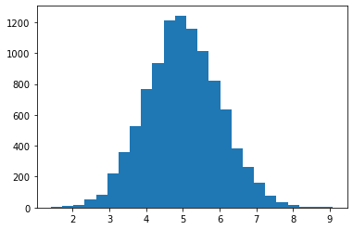
Histograms
>>> plt.hist(numbers, bins=25)
Shows how common different values are
X-axis: values
Y-axis: frequency (count or relative)
Bins controls division points
Pick for clarity and integrity!
import matplotlib.pyplot as plt
This data is symmetrical (not skewed)

Slide 7
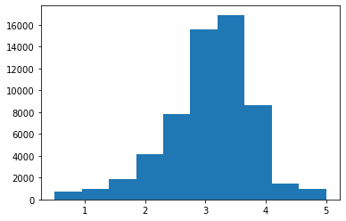
Real Data – Average Movie Rating
>>> movie_info['mean'].describe()
count 59047.000000 mean 3.071374 std 0.739840 min 0.500000 25% 2.687500 50% 3.150000 75% 3.500000 max 5.000000 Name: mean, dtype: float64
>>> plt.hist(movie_info['mean'])
Slight left skew
Mean less than median
Longer tail on the left of the histogram

Slide 8
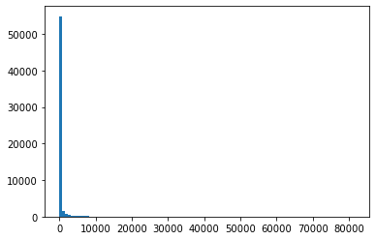
Real Data – Movie Rating Count
>>> movie_info['count'].describe() count 59047.000000
mean 423.393144
std 2477.885821
min 1.000000
25% 2.000000
50% 6.000000
75% 36.000000
max 81491.000000
Name: count, dtype: float64
>>> plt.hist(movie_info['mean’], bins=100)
Very strong right skew
Mean much greater than median
Most movies have far fewer ratings than mean!
Hard to really see in a histogram

Slide 9
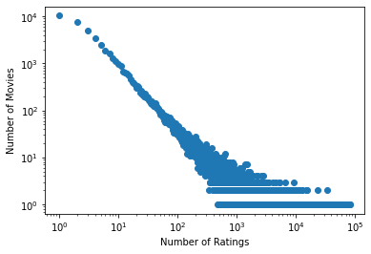
Alternate Histogram
hist = movie_info['count'].value_counts() plt.scatter(hist.index, hist) plt.yscale('log') plt.ylabel('Number of Movies’) plt.xscale('log') plt.xlabel('Number of Ratings’)
Points rather than bars
One point per rating count
Plotted on logarithmic axis
The mode is 1 (10⁰)
Power law distribution (almost)

Slide 10
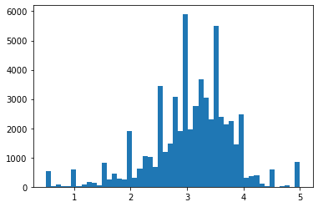
Artifact
Movie mean rating, more bins
Certain values more common!
1, 2, 3, 4, 5, 2.5, 3.5…
These are exact rating values
Because so many movies have only one rating!
>>> plt.hist(movie_info['mean'], bins=50)

Slide 11
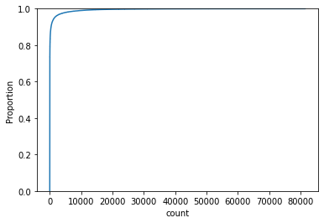
Cumulative Distribution
>>> sns.ecdfplot(movie_info['count'])
Shows how observations accumulate as we go through the range of values.
This data is super skewed…
import seaborn as sns

Slide 12
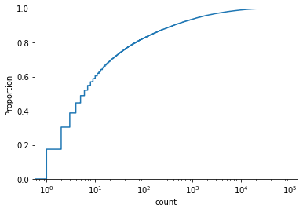
Cumulative Distribution
>>> sns.ecdfplot(movie_info['count'], log_scale=True)
Shows how observations accumulate as we go through the range of values.
Log scaling: accumulation as we increase order of magnitude.
Approximately ½ of movies have 10 or fewer ratings.
Useful for seeing skewed data
Useful for comparing distributions
Obscures mean, median, etc.

Slide 13
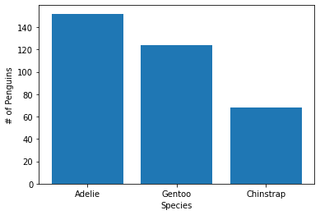
Categorical Distributions
Categorical distributions with bar charts
spec_counts = penguins['species'].value_counts() plt.bar(spec_counts.index, spec_counts) plt.xlabel('Species’) plt.ylabel('# of Penguins’)
Adelie is most common

